Slide 1


Slide 2



Slide 3
CONTENTS :-
WHAT IS COMMAND INJECTION VULNERABILITY ?
COMMAND INJECTION METHODS
MITIGATION
LIVE DEMO

Slide 4
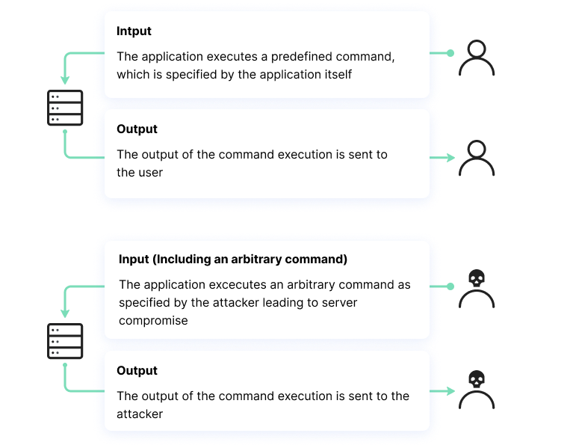
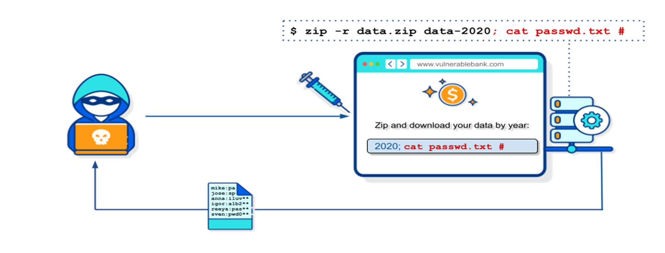
COMMAND INJECTION :-
Command injection is a vulnerability that involves executing arbitrary commands on a host operating system (OS). Typically, the threat actor injects the commands by exploiting an application vulnerability, such as insufficient input validation.

Slide 5

COMMAND INJECTION METHODS :-
Arbitrary command injection
Arbitrary file upload
Insecure serialization
Server-side template injection (SSTI)
XML external entity injection (XXE)

Slide 6
IMPACT :-
The attacker extends the default functionality of a vulnerable application, causing it to pass commands to the system shell, without needing to inject malicious code.
In many cases, command injection gives the attacker greater control over the target system.

Slide 7

MITIGATION :-
Don’t Run System Commands with User-Supplied Input
Use Strong Input Validation for Input Passed into Commands
Use the Principle of Least Privilege
Often Update and Patch Applications
Test the Application

Slide 8


Slide 9
REFERENCES :-
https://brightsec.com/blog/os-command-injection/
https://www.imperva.com/learn/application-security/command-injection/
https://owasp.org/www-community/attacks/Command_Injection#:~:text=Command%20injection%20is%20an%20attack,.)%20to%20a%20system%20shell.

Slide 10
THANK YOU

